Slide 1
Introduction to Data Mining in Financial Analysis
PRESENTED BY
Prajjaval Pandey
Made with SlideMaker.app

Slide 2

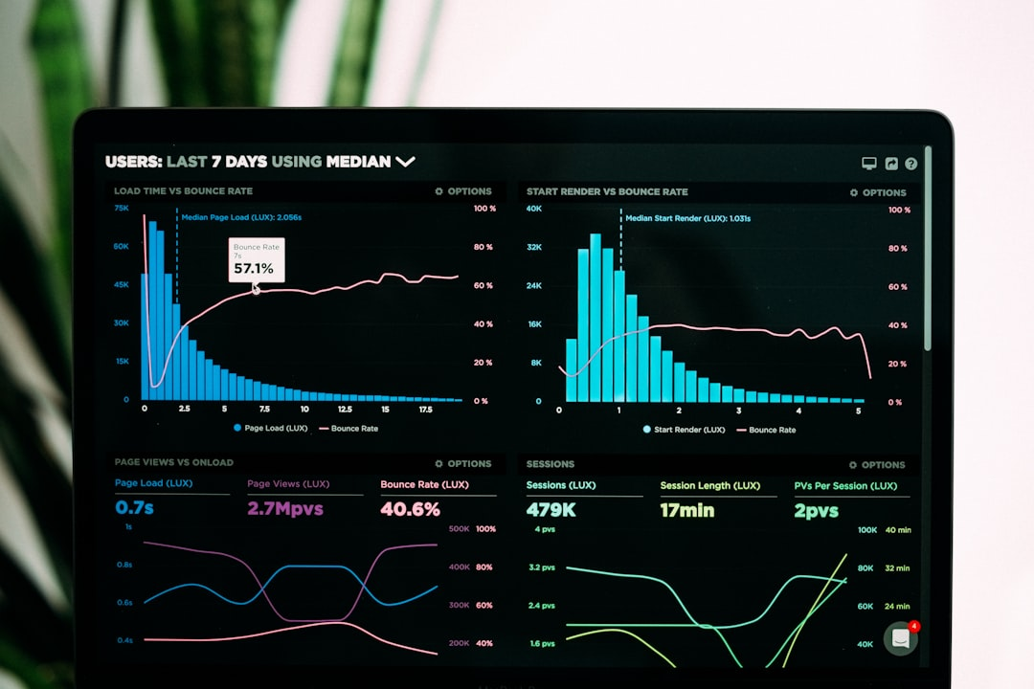
Introduction to Data Mining
Extracting Patterns
Interdisciplinary Approach
Data mining involves extracting meaningful patterns from vast datasets, enabling organizations to uncover insights that drive strategic decisions and improve operational efficiency.
It combines statistics, machine learning, and database systems, creating a robust framework for analyzing complex data and generating predictive models in finance.
Key Applications
Key applications in finance include market analysis, fraud detection, and risk management, allowing analysts to identify trends and mitigate potential financial losses.
Made with SlideMaker.app

Slide 3
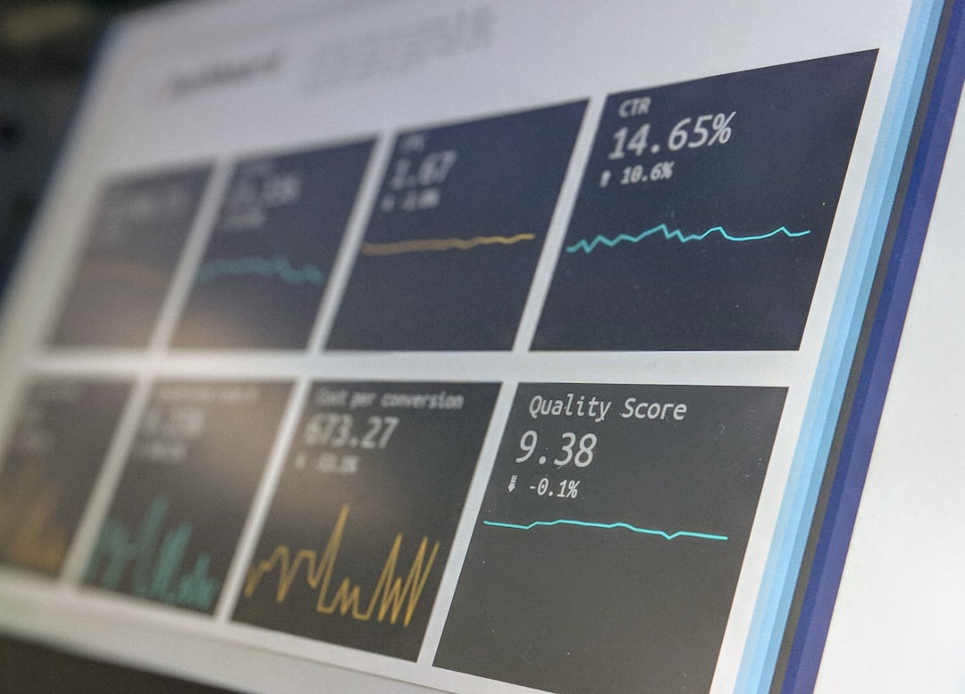
Importance in Financial Analysis
Identifying Trends and Anomalies
Supporting Predictive Analytics
Data mining techniques can uncover hidden patterns in financial data, enabling analysts to identify trends and anomalies that may indicate market shifts or investment opportunities.
By leveraging historical data, data mining enhances predictive analytics, allowing financial institutions to develop robust investment strategies that anticipate market movements and optimize returns.
Improving Risk Assessment Models
Data mining techniques refine risk assessment models, providing deeper insights into potential risks, which helps financial firms make informed decisions and mitigate losses effectively.
Made with SlideMaker.app

Slide 4
Market Trends in Financial Analysis
Made with SlideMaker.app

Slide 5
Techniques Used in Data Mining
Classification Algorithms
Clustering Techniques
Classification algorithms, such as decision trees, effectively categorize financial transactions, improving fraud detection rates by up to 30% in banking sectors.
Clustering techniques, like K-means, group similar financial behaviors, enabling targeted marketing strategies that can increase customer engagement by 25%.
Regression Analysis
Regression analysis predicts future financial trends, allowing firms to forecast revenues with an accuracy of 85%, aiding in strategic planning and investment decisions.
Made with SlideMaker.app

Slide 6



Case Studies in Data Mining
Fraud Detection in Credit Cards
Customer Segmentation in Retail Banking
Risk Assessment in Insurance
Data mining techniques identified fraudulent transactions with 95% accuracy, reducing losses by 30% for major banks, showcasing the power of predictive analytics.
Using clustering algorithms, banks improved targeted marketing strategies, increasing customer engagement by 40% and boosting product uptake significantly.
Data mining models enhanced underwriting processes, leading to a 25% reduction in claim costs by accurately predicting high-risk applicants.
Made with SlideMaker.app

Slide 7
Traditional vs. Data Mining Approaches in Financial Analysis
Traditional Methods
Data Mining Approaches
• Rely on historical data and expert judgment for analysis.
• Leverage algorithms to extract real-time insights from data.
• Utilize established financial models and theories.
• Can process and analyze larger datasets more efficiently.
• May take longer to adapt to market changes due to reliance on past data.
• Identify hidden patterns and trends that traditional methods may overlook.
Made with SlideMaker.app

Slide 8
Transformative Impact of Data Mining in Finance
20%
15%
80%
Profit Increase
Cost Reduction
Adoption Rate
Reported by companies leveraging data mining techniques
Achieved through data-driven decision-making
Of financial institutions utilizing data mining methods
25%
Customer Retention Improvement
Enabled by targeted insights from data mining
Made with SlideMaker.app

Slide 9
Frequently Asked Questions
Q: What types of data are used in financial data mining?
A: Financial data mining utilizes various data types, including transaction records, market data, customer demographics, and economic indicators to uncover patterns and insights.
Q: How does data mining improve risk management?
A: Data mining enhances risk management by identifying potential risks through predictive analytics, allowing organizations to make informed decisions and mitigate losses.
Q: What are the ethical considerations in data mining?
A: Ethical considerations include ensuring data privacy, obtaining consent for data use, and avoiding bias in algorithms to protect individuals' rights and maintain trust.
Q: Can small businesses benefit from data mining techniques?
A: Yes, small businesses can leverage data mining to gain insights into customer behavior, optimize operations, and make data-driven decisions, often with affordable tools and resources.
Made with SlideMaker.app

Slide 10

Key Takeaways
Data mining significantly enhances financial analysis by uncovering hidden patterns and trends. Key takeaways include the importance of data quality, the need for robust algorithms, and the value of real-time analytics. Moving forward, organizations should invest in advanced data mining tools and training to leverage insights effectively. Embracing these strategies will not only improve decision-making but also drive competitive advantage in the financial sector.
Made with SlideMaker.app

